Slide 1



Rotmantic Team 10
Fabiola Grace
Feng (Kay) Zhou
Jinjia (Jason) Shi
Xiaofeng (Vita) Liu
Yunrong (Kuma) Liu

Slide 2

Our team
Do you know what helps you make your point clear?
Lists like this one:
They’re simple
You can organize your ideas clearly
You’ll never forget to buy milk!
And the most important thing: the audience won’t miss the point of your presentation

Slide 3
Implementation details
Main | Our first iteration of command-line interface
User | User is class with attributes user_id, account, password, name, age, gender, location, interests,introduction, liked_users, disliked_users, matches Age is filled out as date of birth from the UI, but stored as current age Gender is restricted to the option of Male/Female/Others in the UI Interests are restricted to the options listed in the UI 2) User has functions to like and dislike users, as well as assign weights for our matching algorithm
Database | Using SQLite to add,edit,delete, fetch and update user profiles
GUI | Using tkinter library to build GUI from the login page to main application interface

Slide 4
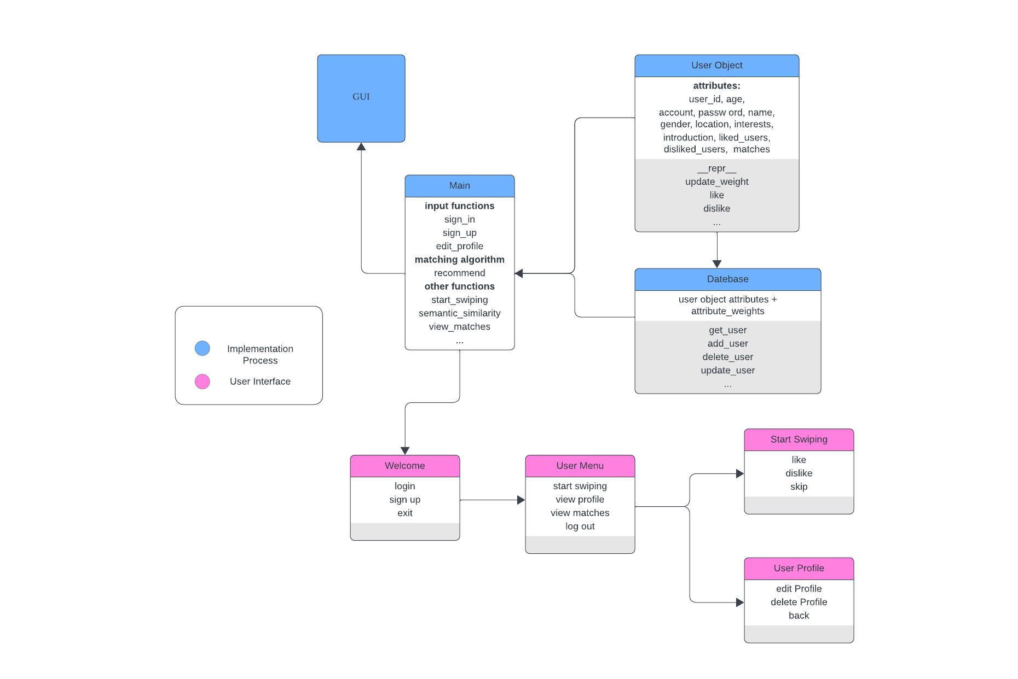

Slide 5
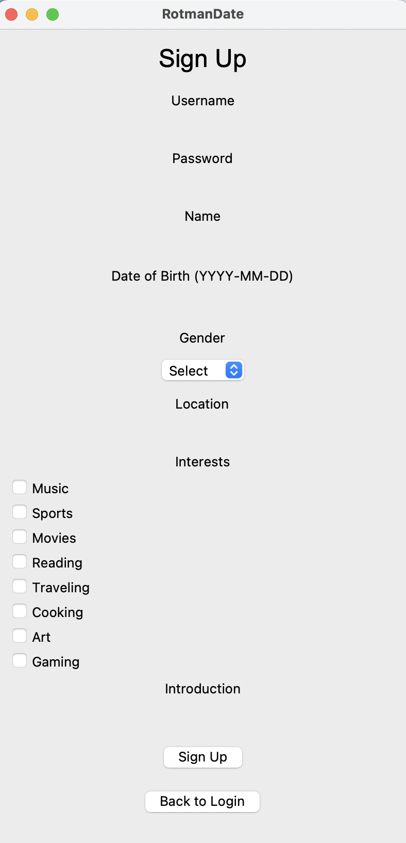
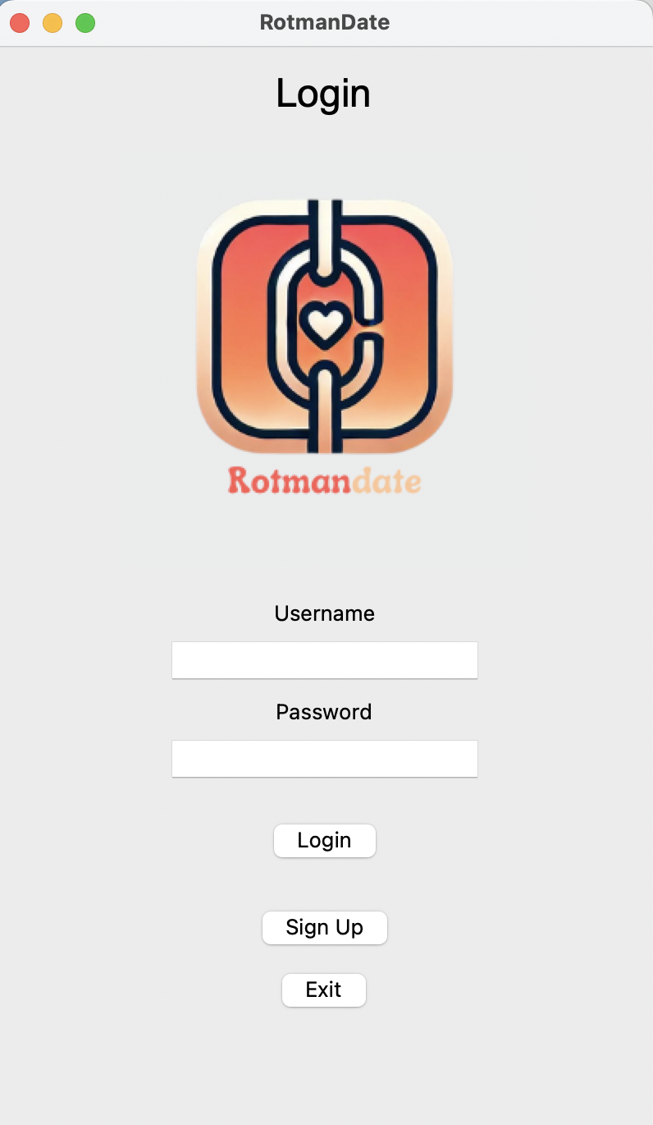

Slide 6
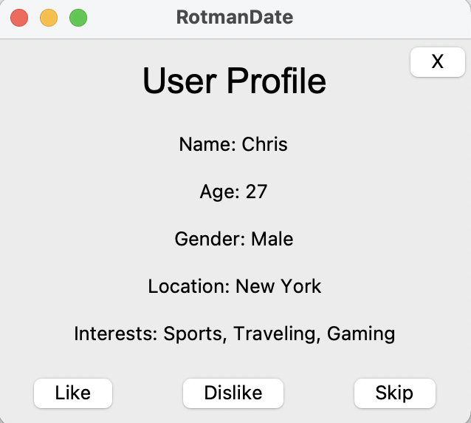
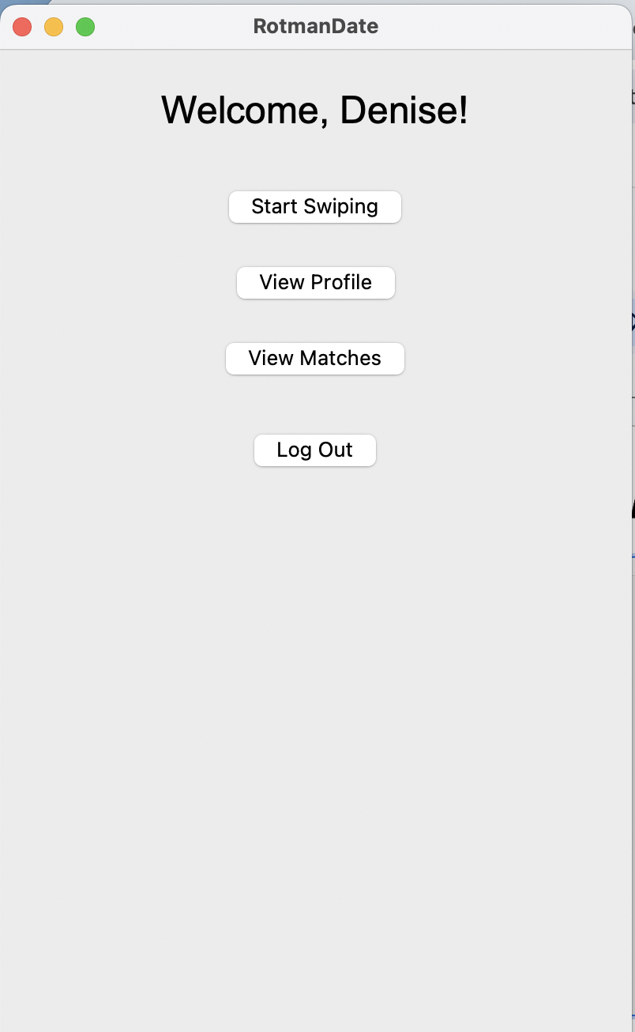
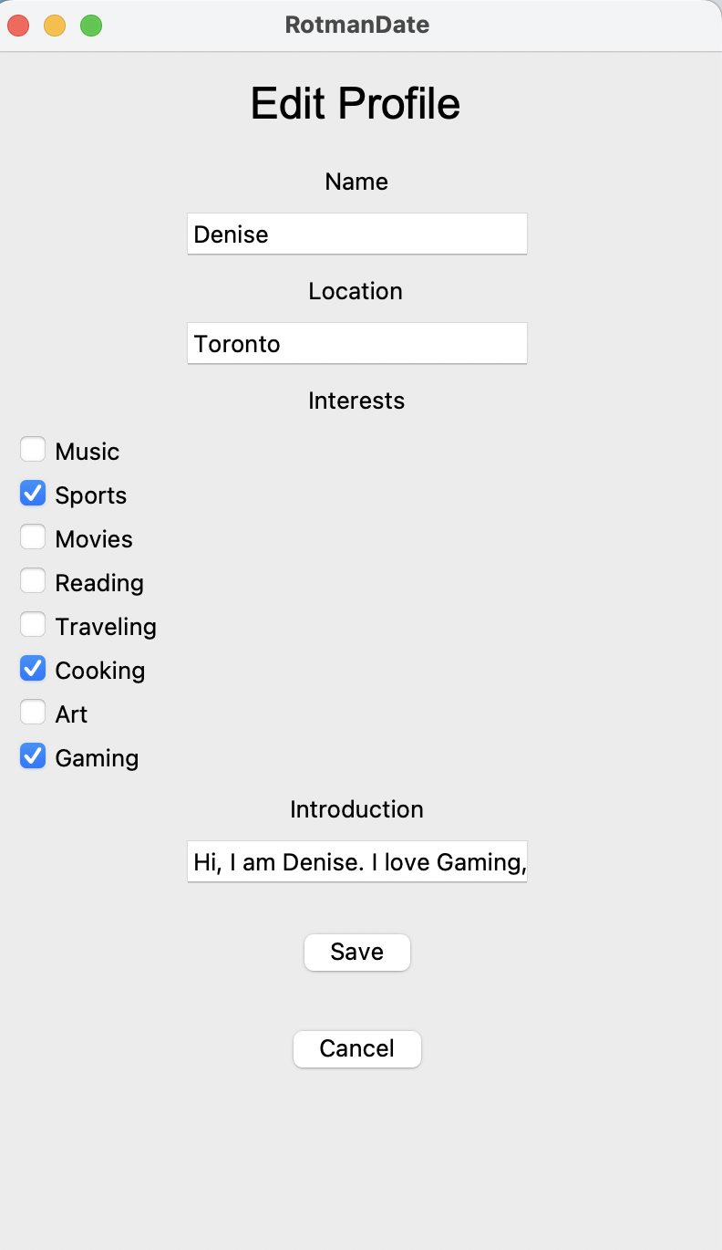
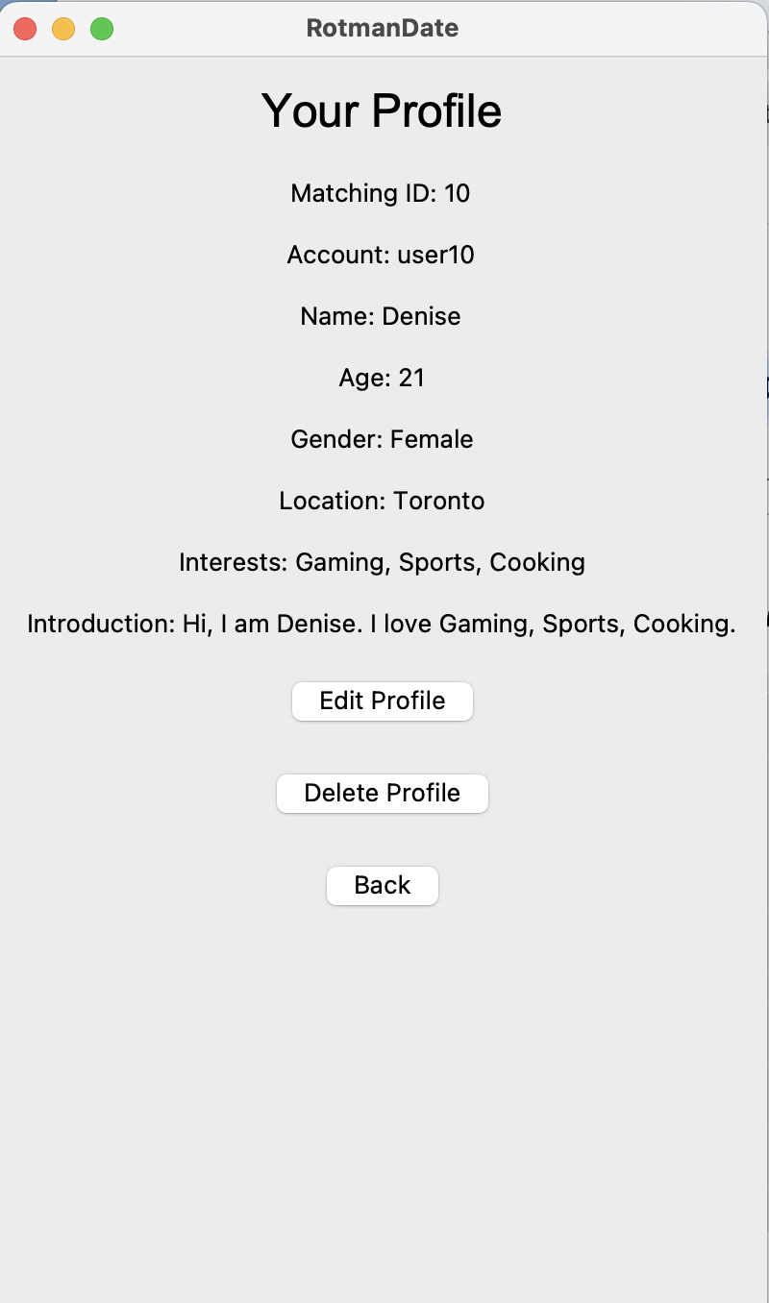
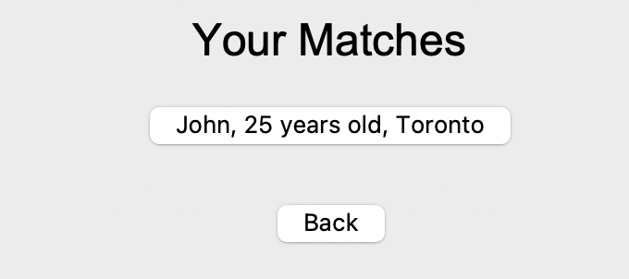
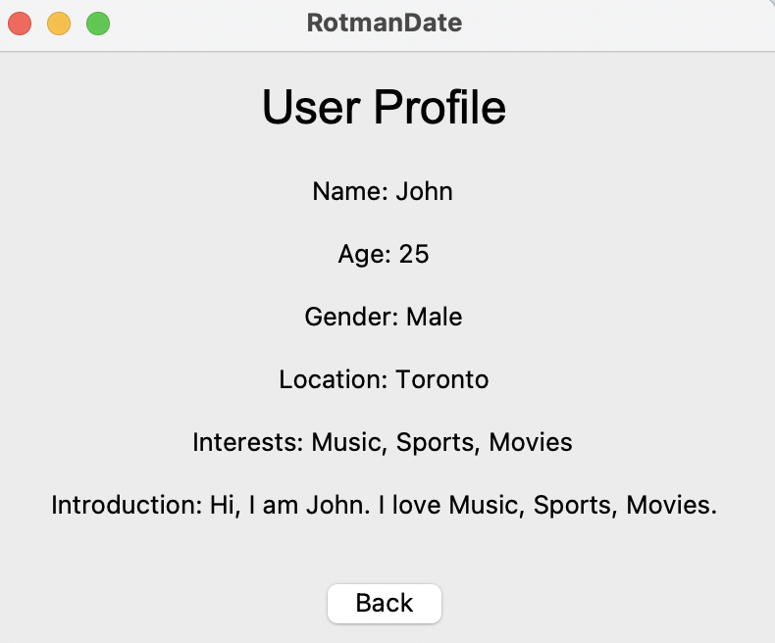

Slide 7
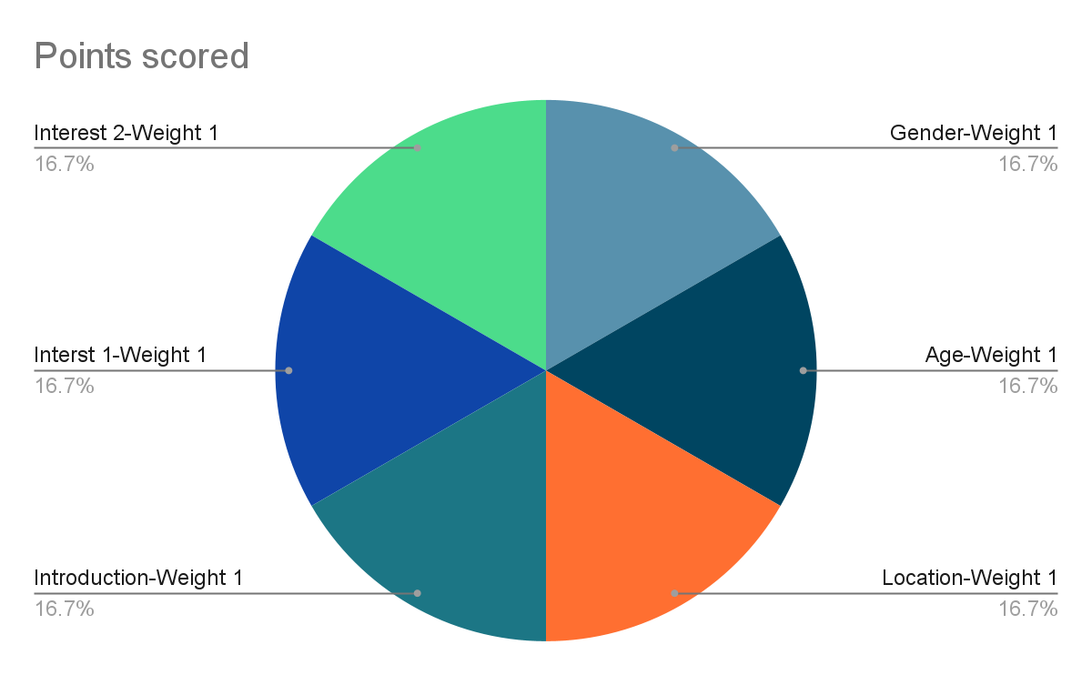
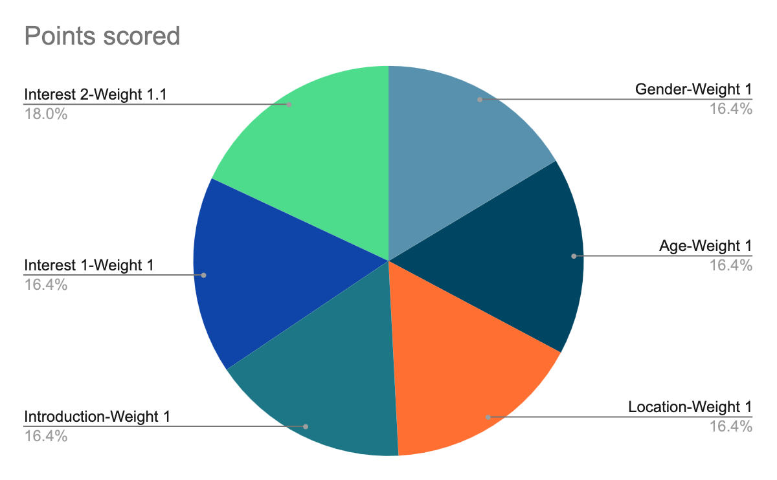
Matching Approach
Gender
1.0
1 Like swipe to User with similar interest 2
Introduction
1.0
Age
1.0
Interest 1
1.0
Location
1.0
Interest 2
1.0
Initial Weights: When a user is created, each attribute is assigned an initial weight of 1.0.
Liking a User: The weight is updated with a multiplier of 1.1
Disliking a User: The weight is updated with a multiplier of 0.9
For example, User A likes User B. Suppose they both have "Music" as a shared interest. The weight for "Music" on User A increases by 10% (from 1.0 to 1.1).
When matching User A with potential matches, the algorithm sums the weighted contributions of all matching attributes to calculate an overall match score. Users with higher match scores are considered better potential matches.

Slide 8
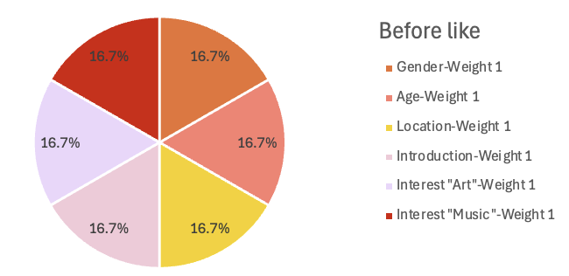
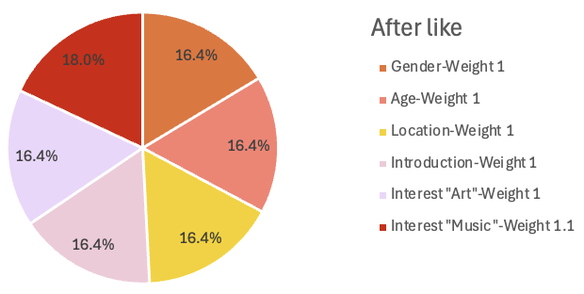
Recommend Algo & Semantic Approximation
Attributes ->Initial Weights-> 1.0 (Male:1, Female:1, Age+-5:1, Introduction:1, Each Interest:1)
Liking a User: That weight x 1.1 OR Disliking a User: That weight x 0.9
Pick a Parameter by weighted probability. Eg: P(Pick Interest ‘Music’) = 1 / (sum of weight = 7) -> recommend a user with same interest
-> After Like/Dislike, immediately update the weight of that factor=> the more you use, the more it will recommend as you wish
Interest:By Keyword search (Choose up to 10 Keywords).
Introduction:NLP Algo called semantic approximation -Black box algorithm
-> Find similar word segment
User A likes User B with a shared interest in “Music”

Slide 9
Demo software

